Slide 1
Probabilitic Feature Selection
(Filter method)
Ashutosh Upreti . Siddharth Mundada

Slide 2

Major Components
Introduction
Previous Work
Our Approach
Experimental Setup
Conclusion and Future Work

Slide 3

Feature Selection
.
INTRODUCTION
Feature Selection and its importance in text classification
Types of Feature Selection methods
Filter Methods
Wrapper Methods
Embedded Methods

Slide 4
PREVIOUS WORK
Distinguishing Feature Selector (DFS)
Improved Gini-Index Algorithm
Chi-square with K-Means

Slide 5
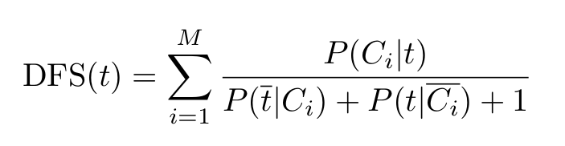
DISTINGUISHING FEATURE SELECTON (dfs)

Slide 6
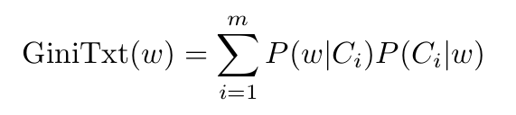
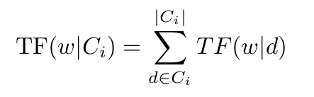
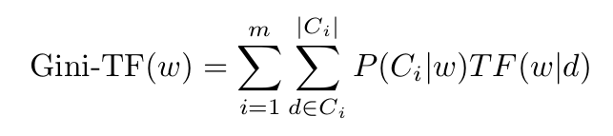
IMPROVED GINI-INDEX ALGORITHM

Slide 7
cHI-SQUARE WITH K-MEANS
Apply
FINAL FEATURE SET ‘F’
APPLY K-MEANS CLUSTERING USING EUCLIDEAN NORM
CREATE ‘K’ CLUSTERS ON THE NEW TERM-DOCUMENT MATRIX
CHI-SQUARE FEATURE SELECTION TO ENTIRE TERM-DOCUMENT MATRIX

Slide 8
OUR APPROACH
Gini-DFS
Improved Gini-DFS
Applying K-Means before Improved Gini-DFS

Slide 9
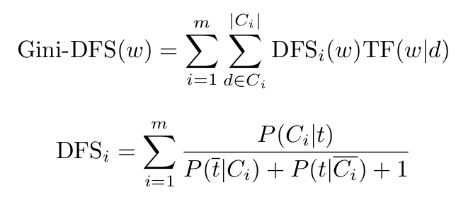
Gini-Dfs

Slide 10
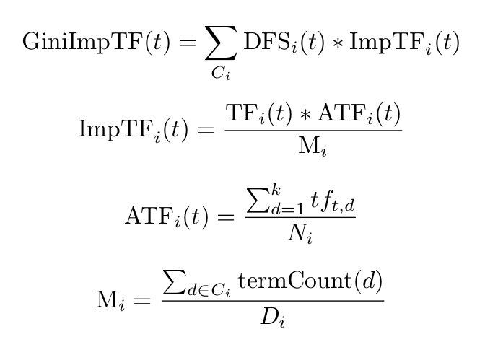
IMPROVED GINI-DFS

Slide 11
K-MEANS WITH IMPROVED-GINI-DFS
Applying K-Means Clustering to preprocess the data
Using a threshold, we select the top-N features from every cluster
Feature set constructed is passed to Improved-Gini-DFS

Slide 12
Experimental setup
Dataset Information
Classification Algorithms
Performance measures
Experimental setting
Visualizations

Slide 13
DATASET INFORMATION
WebKB
Reuters-8
Newsgroup20

Slide 14
CLASSIFICATION ALGORITHMS
Support Vector Machine (SVM)
Multinomial Bayes Classifier
Random Forest Classifier

Slide 15
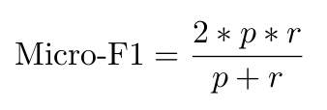
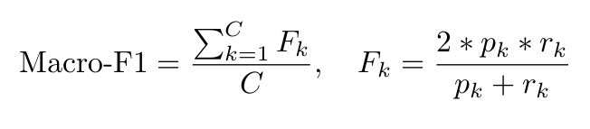
Performance measures

Slide 16
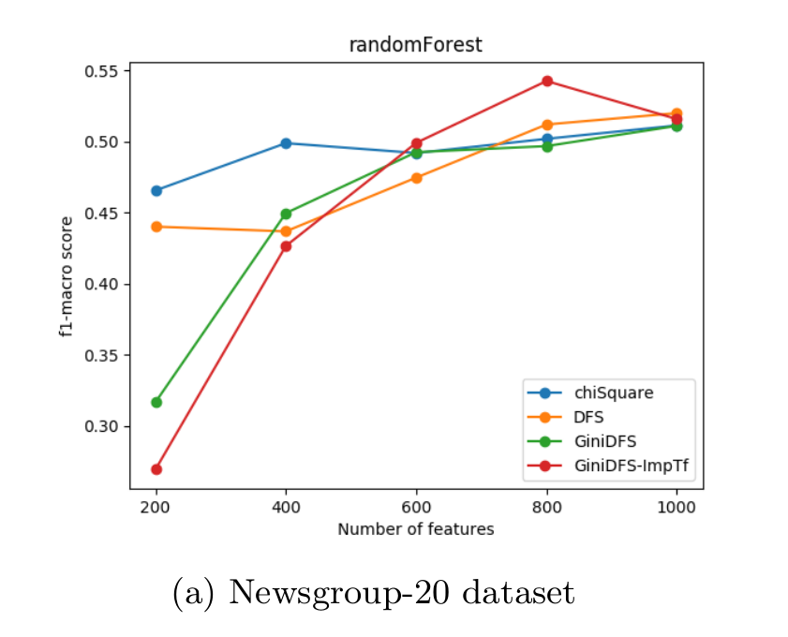
VISUALIZATIONS

Slide 17
VISUALIZATIONS

Slide 18
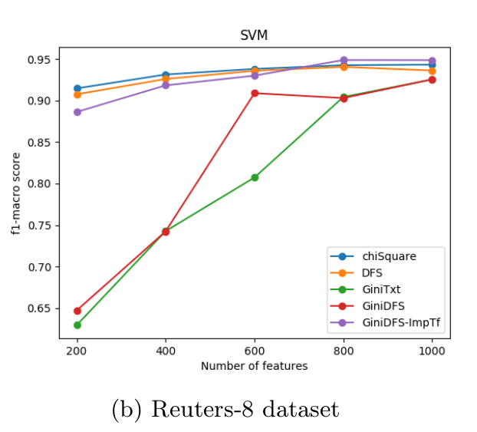
VISUALIZATIONS

Slide 19
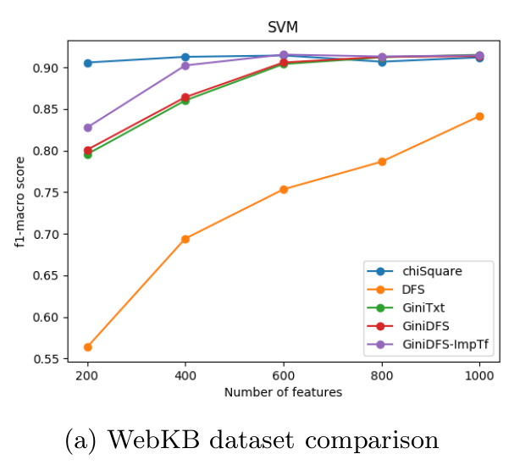
VISUALIZATIONS

Slide 20
CONCLUSION AND FUTURE WORK
Dataset can be skewed in nature. In such cases, inclusion of TF (term-frequency) in the scoring function proves to be useful.
Filter methods sometimes become vulnerable to high frequency terms.
Performance of feature selection techniques rely on the classifier used.
In our future work, we can use model probabilities with different probability distributions. We can also use a weighted scoring function.

